Slide 1
St Rita
Our Pledge: Every dollar donated is going toward a project to support someone in need or to help a child build a better future.
All overheads are kept to a minimal and covered by the founders.

Slide 2
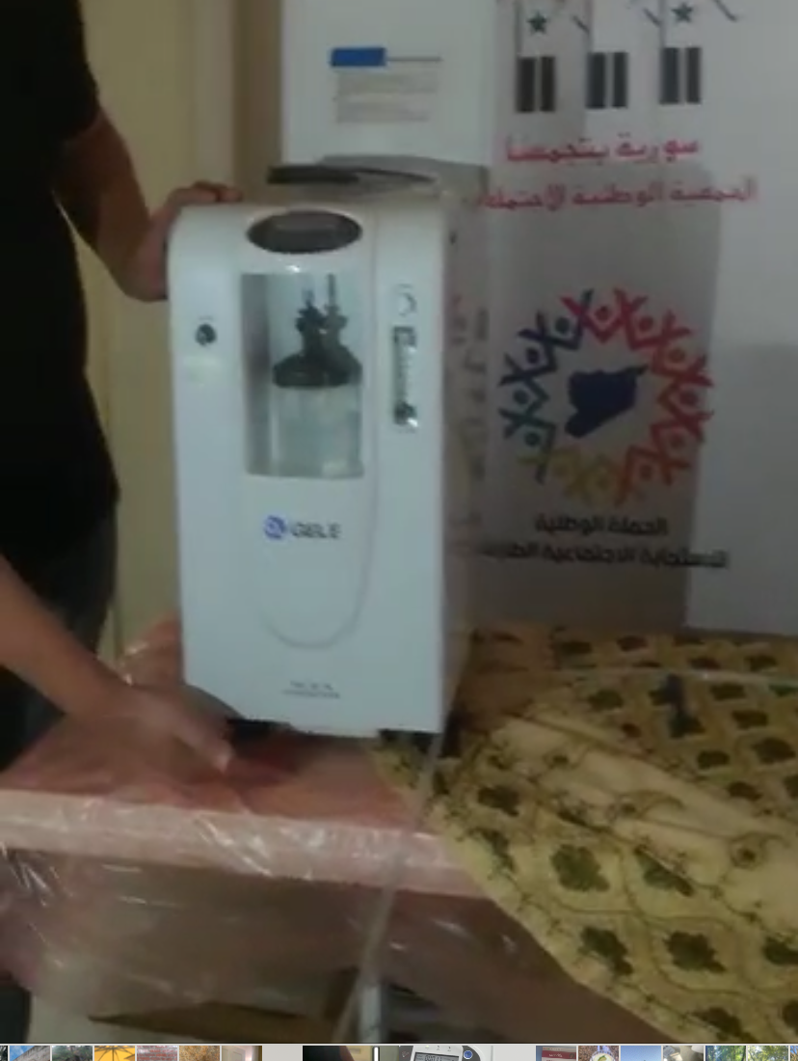
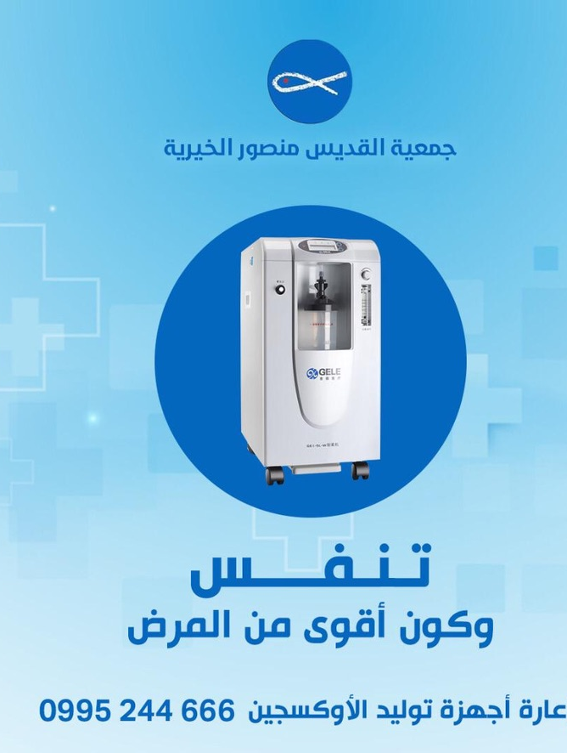
Update on August 2020 Plea:
With a tremendous support from our donors, St Rita Foundation was able to raise enough funds to send 200 oxygen concentrators to Syria. The concentrators were donated to different charities including “Syria unite us” and Saint Mansour and are offered free of charge to needy patients based on doctor’s recommendations.
We also donated 20,000 surgical quality masks .
This project is closed for now until we identify more needs.

Slide 3
Our Current Projects
SOS , St Rita is currently sponsoring 30 children
Food baskets distribution in Syria
Coat project
Supporting the dialysis center for Saint Mansour in Damascus

Slide 4
SOS (insert link)

Slide 5
Food Baskets A Plea For Help
During the month of July Saint Rita distributed 5000 food baskets to different charities. Each basket contained over 14 kg of dry goods. Each basket costs $15
This is an ongoing project that is critical to fight the current state of famine in Syria after 10 years of a terrible war followed by COVID crisis, fires, and economic sanctions.

Slide 6
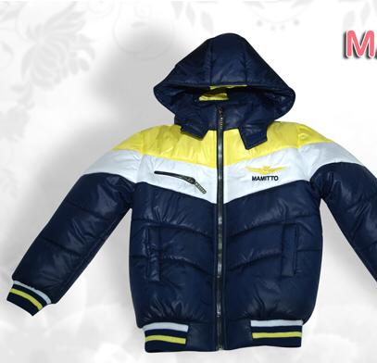
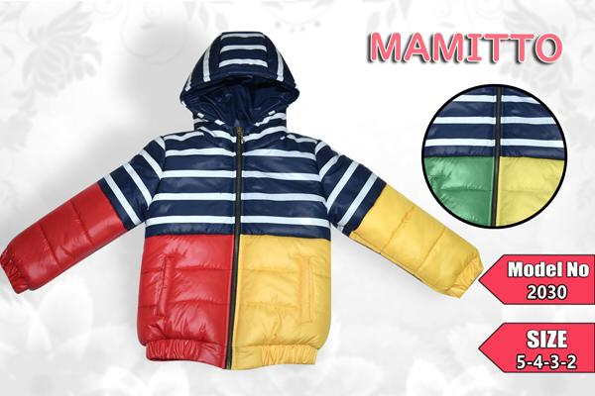
The Coat Project
We are partnering with a local factory to manufacture as many coats as possible to donate to orphanages and charities to distribute to children
These coats may be the first item of new clothing ever received by some of those children.
The cost is $6.80 per coat. We are still taking donations.

Slide 7
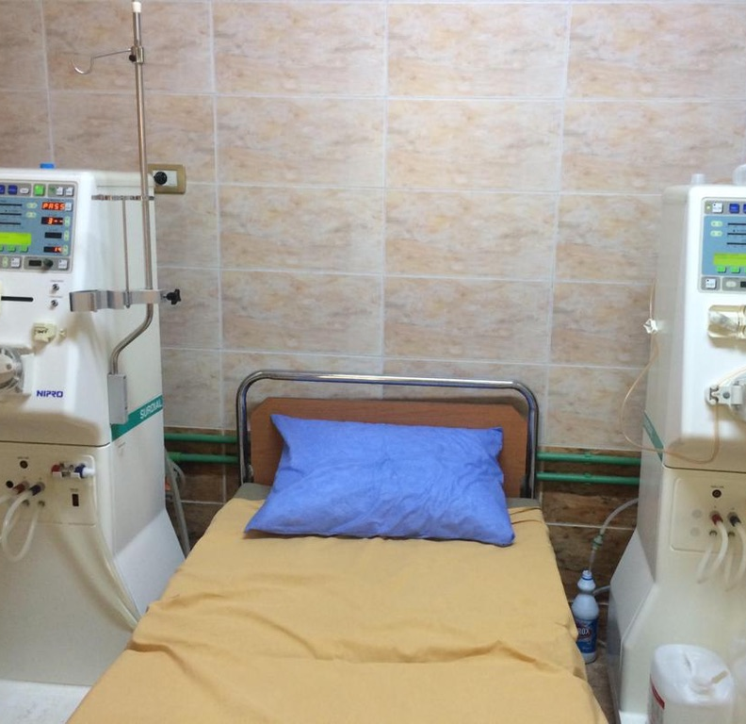
The Dialysis Center of Saint Mansour
This center offers free dialysis to any patient who needs it free of charge regardless of their religion.
Dialysis is also offered for free at the University and County Hospitals however there is a long wait list for the service. This small center supported by Saint Mansour society is saving many lives. It bridges the gap in care while patients are waiting for a slot in the big hospitals.
The center has 2 machines only. Each dialysis session costs $25. they are only able to help 4 patients per day.
We are committed t help St Mansour purchase 2 new machines and with their daily costs.
Please donate to this cause. One patient needs at least 8 sessions per month.

Slide 8
Thank You to Our Friends and Partners
DU 88 a fantastic group of physicians who graduated from Damascus University School of Medicine in 1988. This group of amazing doctors have donated thousands of dollars in addition to their time and effort to identify resources and charities to carry the work on the ground.
All the local charities and unsung heroes in Syria who are helping us reach many children and families.

